Slide 1


UX Assessment & Recommendations Report Northwell Health
© COGNIZANT SOFTVISION 2021
Notes:
Final

Slide 2
GOALS & APPROACH
As part of an organizational initiative to commercialize an internal consolidated data visualization tool (RAD), Northwell Health is seeking to evaluate the current application and imagine a next generation product for emergency department administrators and front-line workers.
Our approach for the UX assessment includes:
Discovery with Product Owners / SMEs to gain a deeper understanding of vision and goals
Heuristic Evaluation and Expert Review to Identify Gaps & Opportunities
Conceptualization and Prototyping to inform recommendations & illustrate the art of the possible
Summarize proposed changes and improvements via a Recommendations Report
Notes:
Solutions that can meet the needs of user and realize adaptation.

Slide 3

VISION: PATIENT CENTRICITY
“Patient centricity” means designing health solutions centered around the patient and their care. Creating patient-centric solutions ultimately involves getting input and feedback from real patients and their loved ones and making decisions based on their needs and perspectives – It’s about letting the patient voice drive how we think about the entire healthcare experience.
What does patient centricity mean for RAD?
Enabling emergency department administrators and front-line workers to more effectively manage their data and tasks can have a positive and measurable impact on patient care and satisfaction.

Slide 4
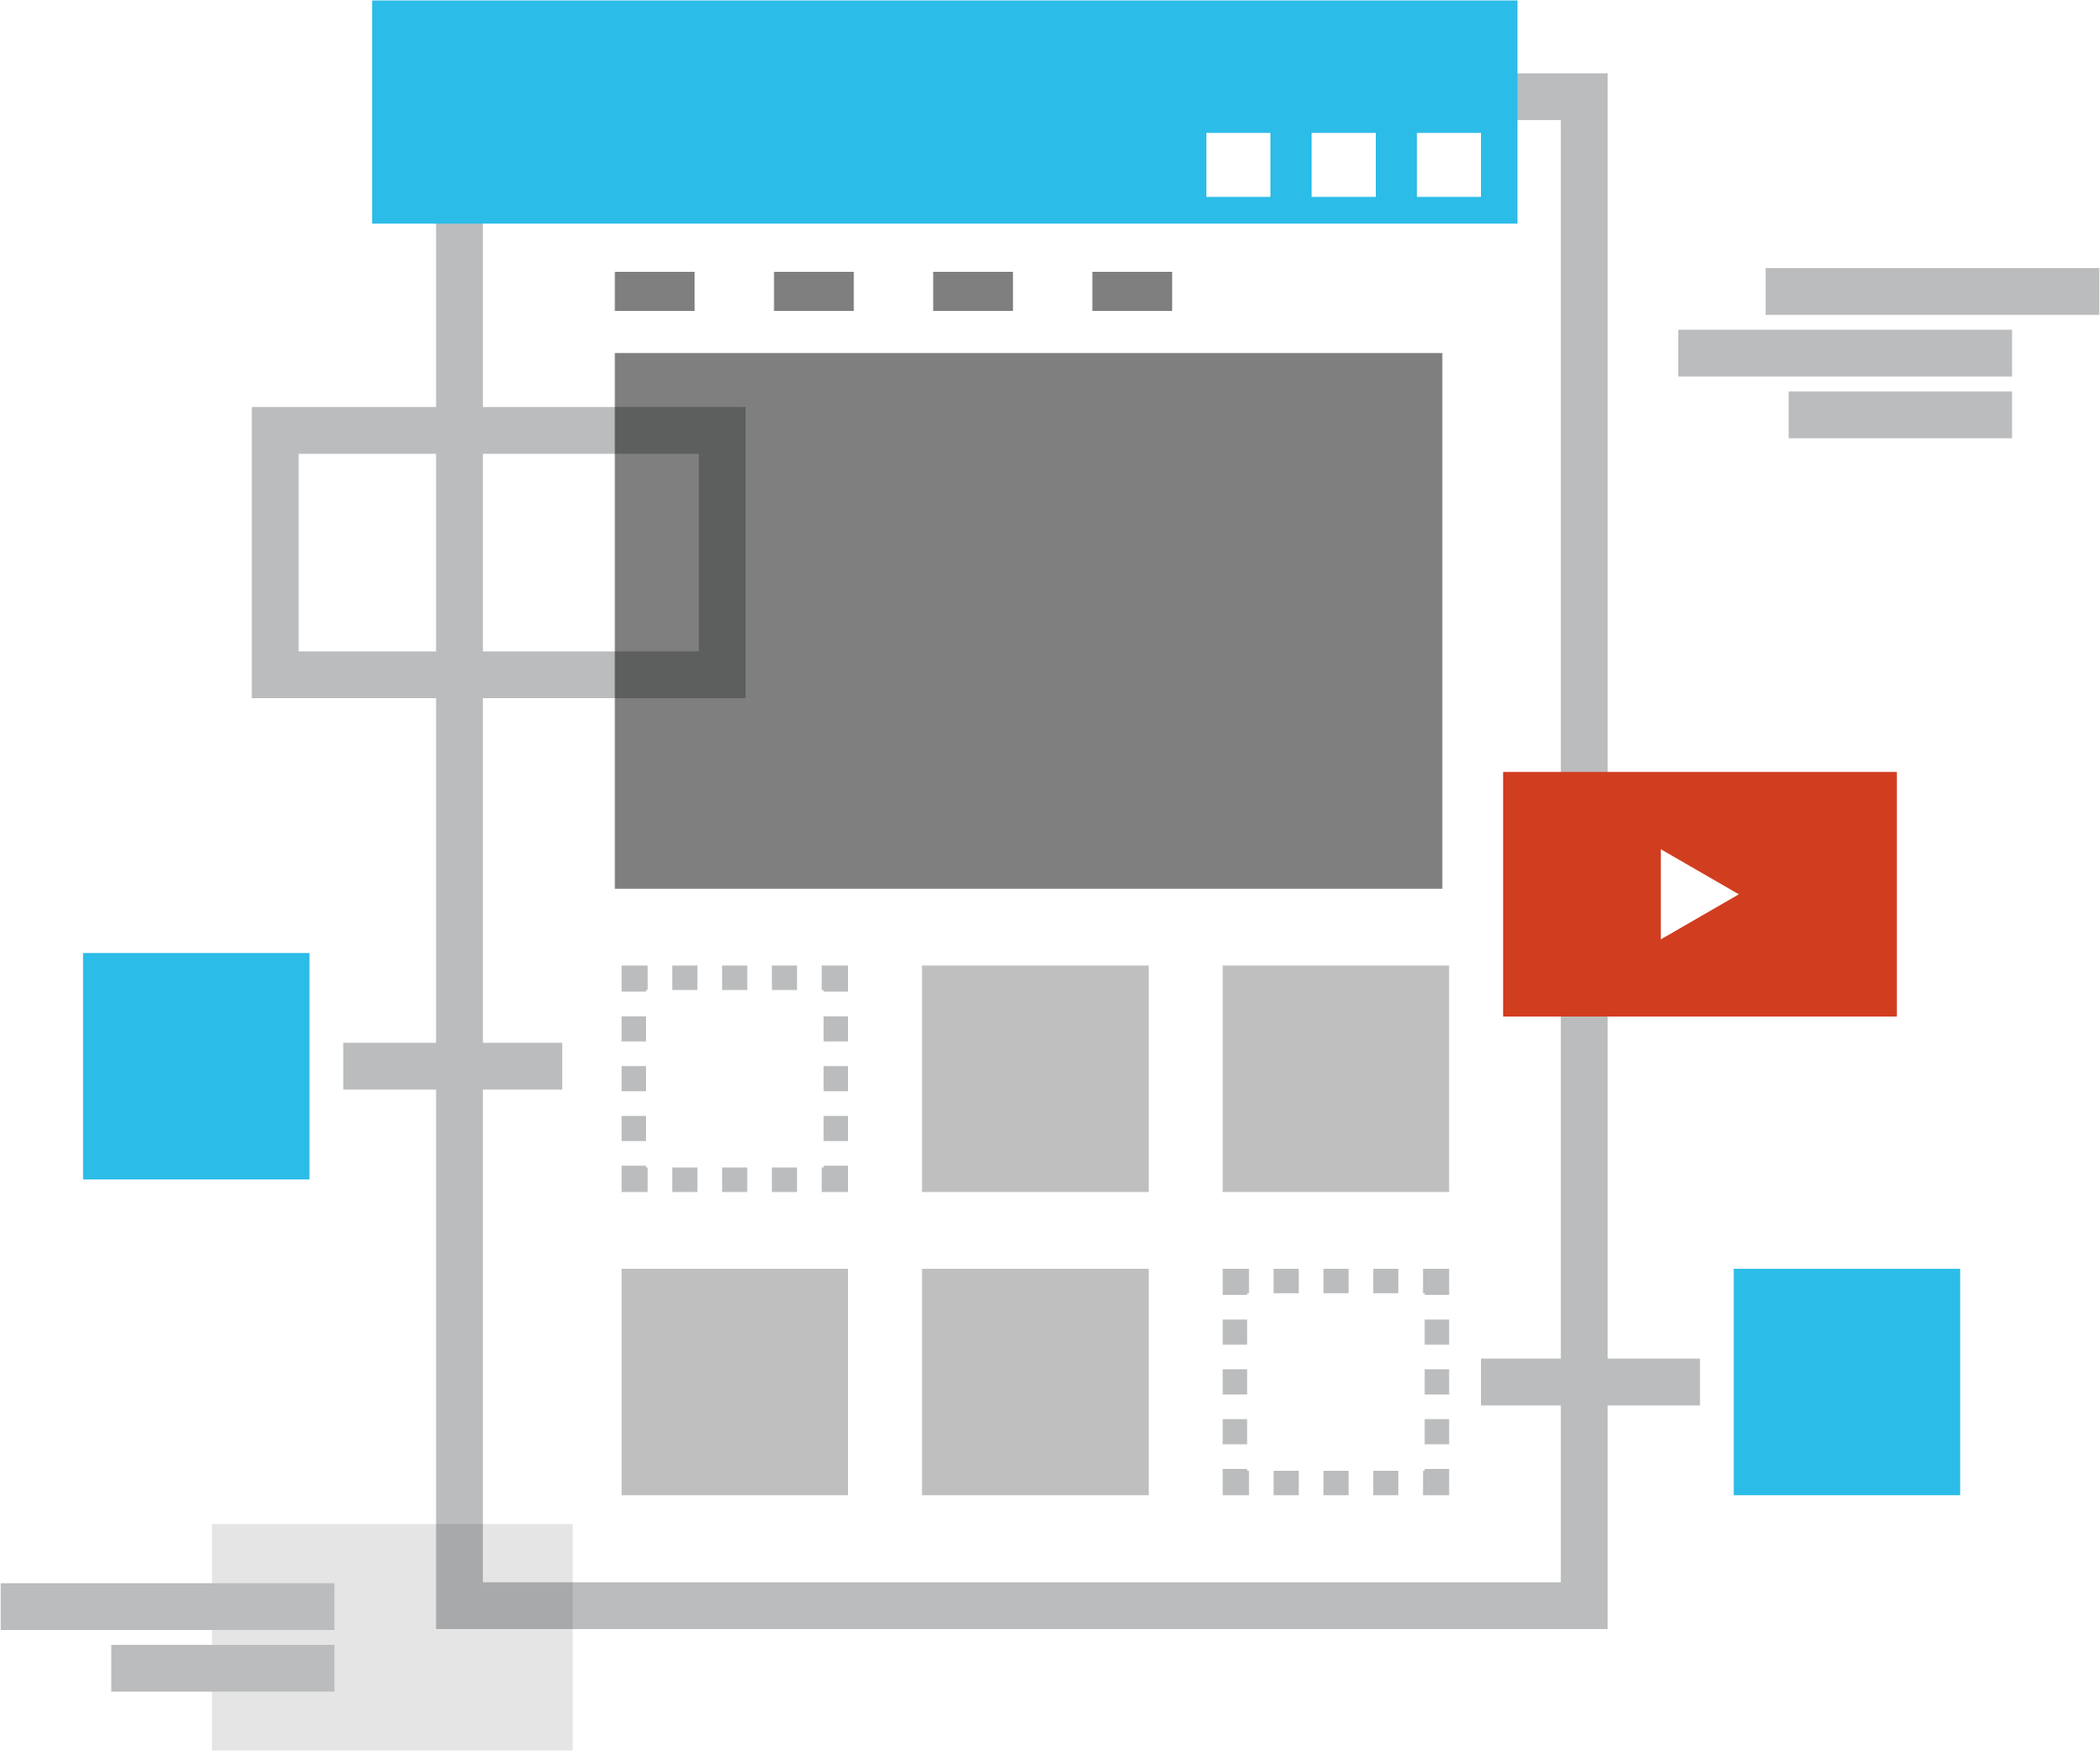
EXPERT REVIEW METHODOLOGY
The expert review assesses a system (such as a website, application or section therein) for compliance with heuristics, known usability guidelines, principles of usability-related fields such as cognitive psychology and human-computer interaction, and the reviewer’s expertise and experience in the field.
The UX expert determines whether the design meets its objectives and provides a good experience, captures issues, and makes recommendations for improvement via a summary report.
The expert review will also include one round of ideation and prototyping to validate and further inform recommendations. The resulting report will include the evaluation summary, recommendations for improvements, and any concepts created during ideation.

Slide 5
HEURISTIC CHECK LIST
Overview
Navigation and UI patterns are consistent
Repetitive actions or frequent activities feel effortless
Users can easily recover from errors
Accessing help does not impede user progress
Visual hierarchy directs the user to the required action
Items on top of the visual hierarchy are the most important
Primary action is visually distinct from secondary actions
Interactive elements are clear and not abstracted

Slide 6
Concepts

Slide 7
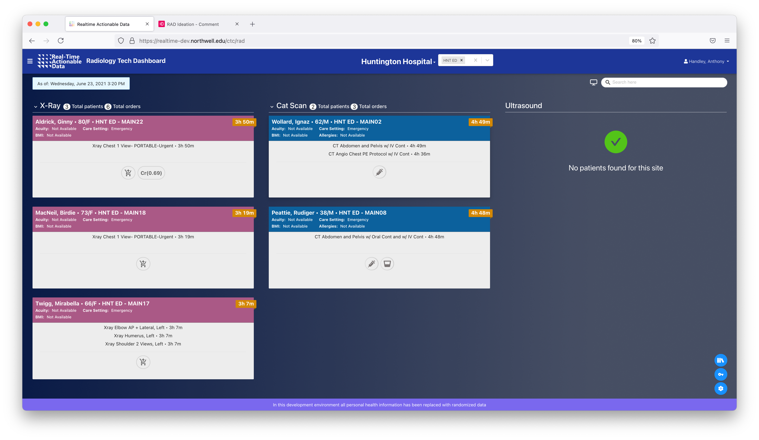
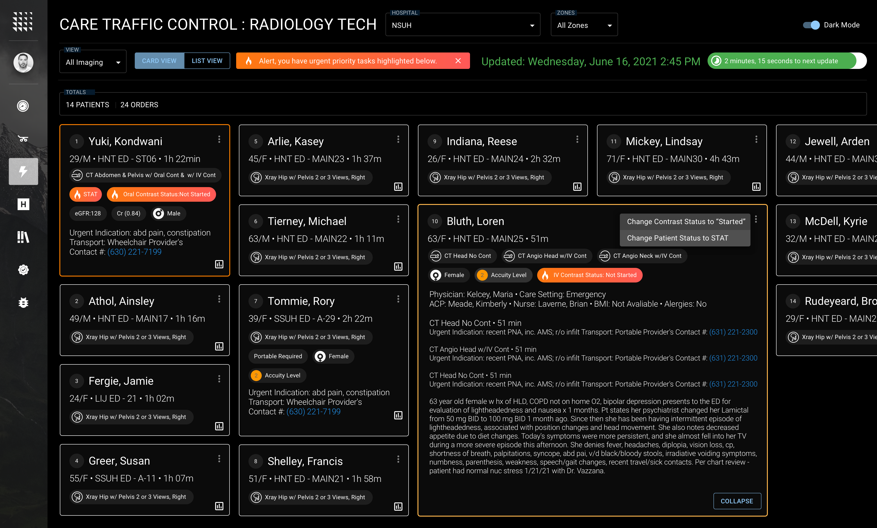
FOCUS & THEMES
During evaluation and conceptualization, the team uncovered the desire to provide additional value beyond displaying data. Conceptualization focused not only on improving the current experience, but also looked for ways to transform the RAD experience into an intelligent ”to-do-list” for administrators, clinicians, and front-line workers.
For this exercise, the team selected and focused on Care Traffic Control for ideation and conceptualization and identified several themes used to inform the recommendations.

Slide 8
CONCEPT
Ideation & Recommendations
Manage Me In The Moment Use multiple data points including duration, acuity level, urgency or other factors to prioritize tasks to show front line workers "what's next and what's coming" via an intelligently prioritized list to to-do’s.
Notify Me When the system intelligently prioritizes or re-prioritizes tasks, the user is given clear, contextual notifications that something has changed.
Surface Detail New task cards use TAGS to indicate attributes such as imaging type, duration, acuity level, etc. to allow front line workers to quickly scan an item for relevant context.
Focus My Attention Use emphasis of color and opacity to let important data stand out while less important information fades into the background.
2
1
4
3

Slide 9
CONCEPT
Ideation & Recommendations
Keep Me Up-To-Date Provide a clear and easy way to update users on data freshness. A 'progress bar' style indicator can illustrate remaining time and count down the next refresh.
Give Me Control Allow the user the ability to ‘configure’ the experience based on their needs in different scenarios and situations.
Let Me Drill In With Context Highlight the currently selected content and allow me to expand the content area for additional information inline with the rest of the data.
Make It Actionable Let me interact with the data based on my needs. Example: change status based on task completion.
6
6
5
7
8

Slide 10
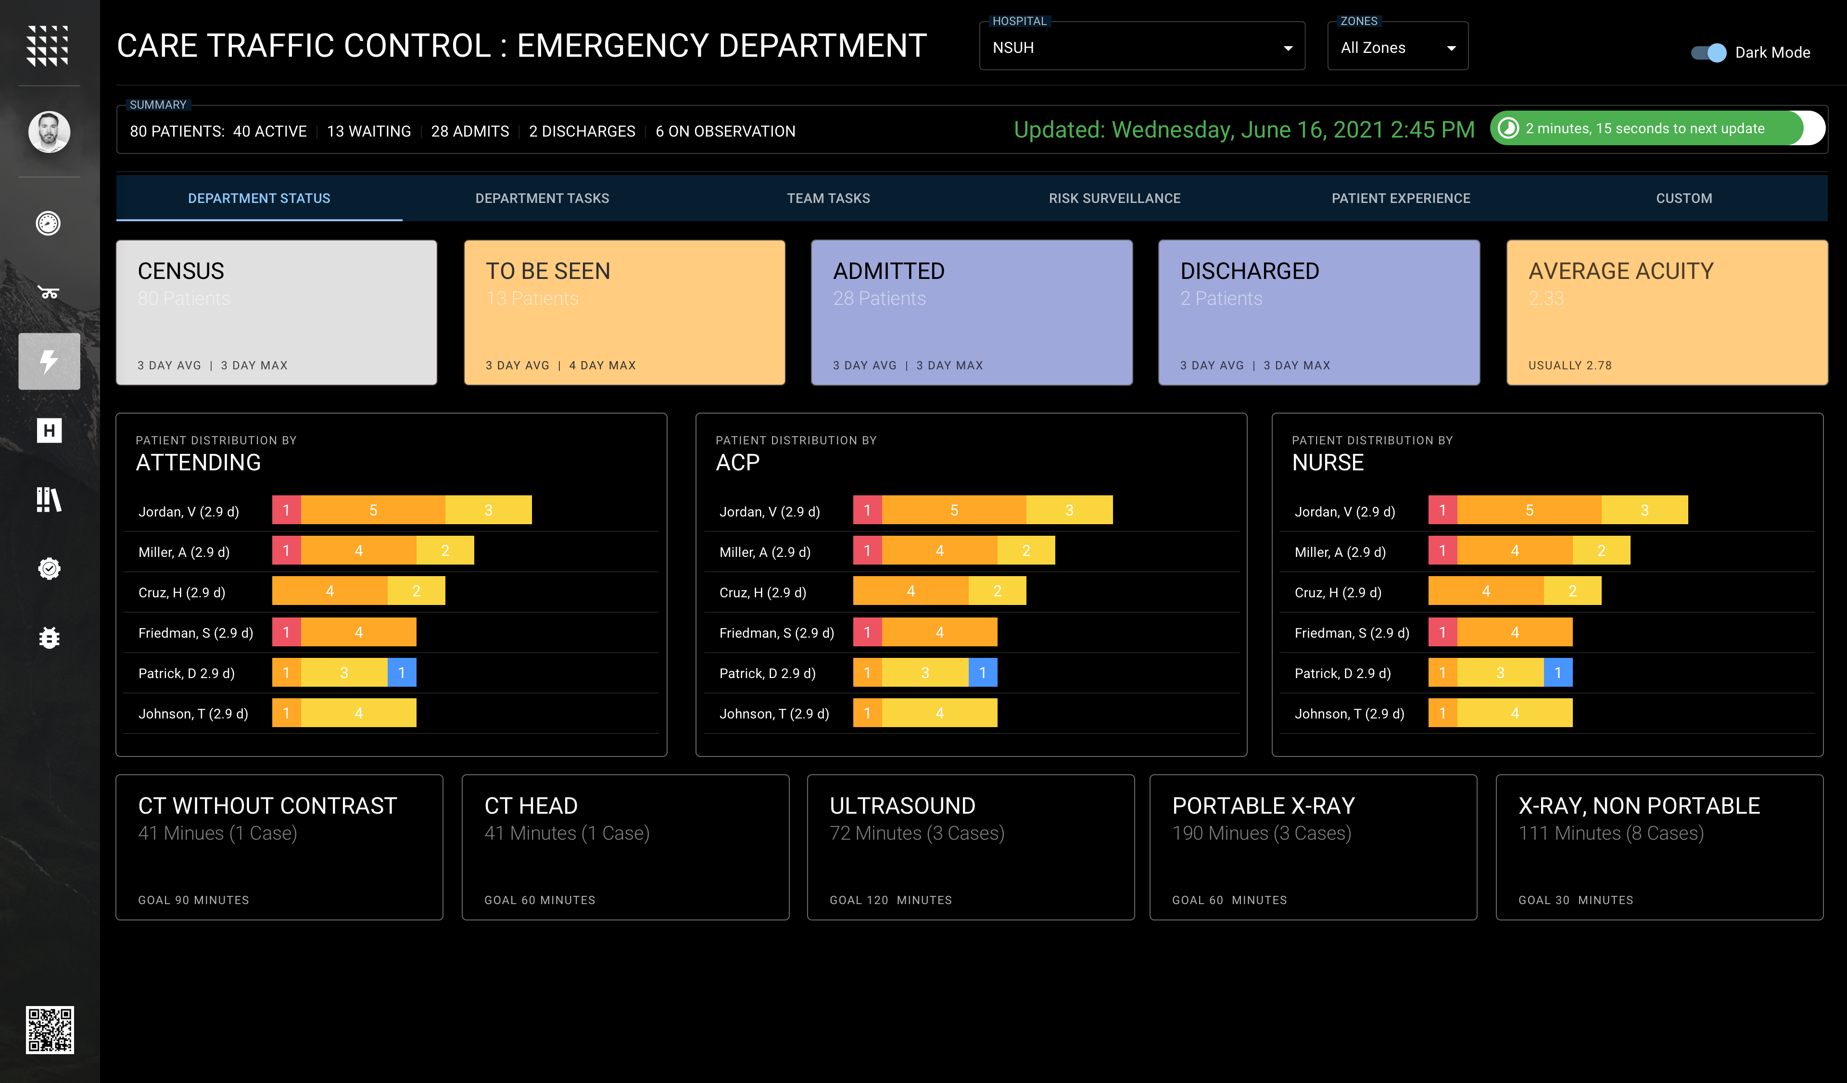
CONCEPT
Ideation & Recommendations
Give Me A Birds-Eye View Provide a clear and easy way for administrators to see important data at-a-glance.
Focus My Attention Use emphasis of color, contrast, and opacity to let important data stand out while less important information fades into the background.
9
10

Slide 11
Design Considerations

Slide 12
GENERAL DESIGN PRINCIPLES
Fundamental usability design principles for RAD product teams
You Are Not The User Clients have different goals and motivations than product teams and employees. Even if you are a former user, practitioner or have worked in the domain for 20 years. Avoid thinking you can predict user behavior, pain or unmet needs without engaging in a continuous cycle of research, testing, validation, and confirmation. Let the data drive product definition and features.
Know Your User There are several widely-practiced research techniques such as client interviews, subject- matter expert interviews, usage data analysis, and contextual inquiry that can be used to help you form an objective, unbiased model of your customers' needs.
The User Is Not The Designer Avoid confusing listening to customers with taking instructions from them. Customers often cannot tell you what they want. Research and real-world examples prove that it is hard enough for users to predict their own future behavior, much less what the rest of your clients need. It is the job of designers and product owners to use appropriate methods (such as research and discovery) to elicit feedback, interpret it, and let it inform feature design.
Design Answers, Not Tools The primary goal of RAD is to inform, guide and provide immediate answers in critical healthcare scenarios. In most cases, product teams should aim to provide the right answers immediately. Understand the needs of different types of users and personalize the experience for them.
Define A Feature's Purpose Narrowly Product teams should scope features narrowly and explicitly. Avoid broadly-defined purposes such as, "My feature should inform the user what's happening in the ER."
Practice Consistency Consistency across RAD features is critical. Users should be able to quickly understand how the system works and apply that understanding across the breadth of the product. To ensure consistency, adhere to established design patterns and leverage a common design system and avoid tackling previously solved problems.
Make Screens Predictable A feature should be so easy to use, it requires minimal user documentation. Well designed features "feeds" user actions so they feel they know where they came from and where are going. A well-designed feature also acknowledges user actions via feedback where appropriate and uses embedded help strategies to provide clarification and guidance when and where needed.

Slide 13
GENERAL DESIGN PRINCIPLES (continued)
Fundamental usability design principles for RAD product teams
Choose Good Defaults Don't force users to make unnecessary, obvious, or tedious choices. Provide optimal defaults whenever possible so the initial barrier to entry is low. Allow users can change the defaults if needed. For example, the initial view of an intelligent list should organize patients based on priority or imaging type based on various factors such as time in ER, acuity factor, urgency, etc. to “manage the user in the moment”. Test Multiple Concepts/Features Early And Often Develop concept options and elicit customer feedback early in the process. Visualize and explore alternate approaches to solving your problems to help solidify ideas and gather useful feedback from stakeholders and users alike.
Prioritize the Majority (80/20 Rule) While is may be tempting to attempt to address all the needs discovered during your research. Resist that urge. "Long tails" of features are very costly to address, both in terms of added complexity and resources. Start with a simple solution that covers 80% of use cases. Design and build a system so product teams can easily iterate, and update based on new business goals and user needs.
Lead With Key Data Users love dashboards that cut through visual noise and communicate confidence and decisiveness by leading with key data points to help the user see what’s important in an instant. A dashboard should always save the user time.
Use Color and Icons Sparingly and With Intent Too many color choices can be overwhelming and can cause more confusion than clarity. Icons are useful if paired with text labels. Never use an icon where a word or phrase would suffice.
Use Motion and Functional Animation Animation is no longer just for delight; it is one of the most important tools for successful interaction. Functional animation is a subtle animation embedded in the UI design as a part of the functionality of that design. It reinforces the design and has very clear and logical purposes including:
Reduce cognitive load
Prevent change blindness
Establish better recall in spatial relationships
Animation can help bring user interfaces to life by considering expectation, continuity, narrative and relationship. In a human-centered design approach, where the user is the prime focus, a user interface needs to be intuitive, responsive, and human. Functional animation can help you achieve these goals.

Slide 14
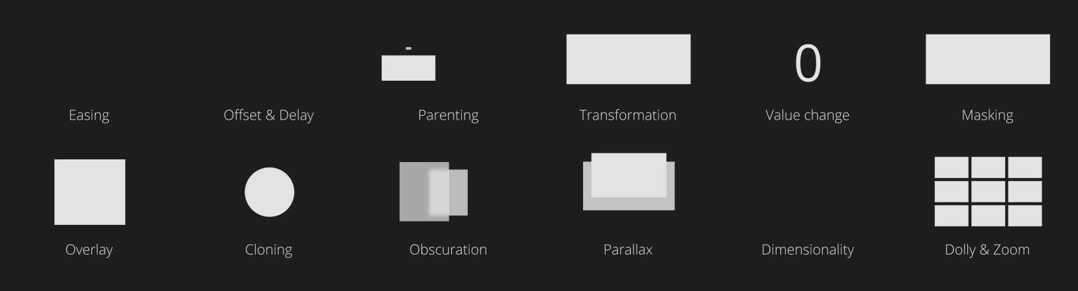
CREATING USABILITY WITH MOTION
Motion supports usability in four ways:
Expectation
Expectation fall into two areas — how users perceive what an object is, and how it behaves. Motion and animation can help minimize the gap between what the user expects, and what they experience.
Continuity
Continuity speaks both to the user flow and to the ‘consistency’ of the user experience. Continuity can be thought of in terms of ‘intra-continuity’ — the continuity within a scene, and ‘inter-continuity’ — the continuity within a series of scenes that make up the total user experience.
Narrative
Narrative is the linear progression of events in the user experience that results in a temporal/spatial framework. This can be thought of as the series of discreet moments and events that connect throughout the user experience.
Relationship
Relationship refers to the spatial, temporal, and hierarchal representations between interface objects that guide user understanding and decision making.
Example Motion Patterns

Slide 15
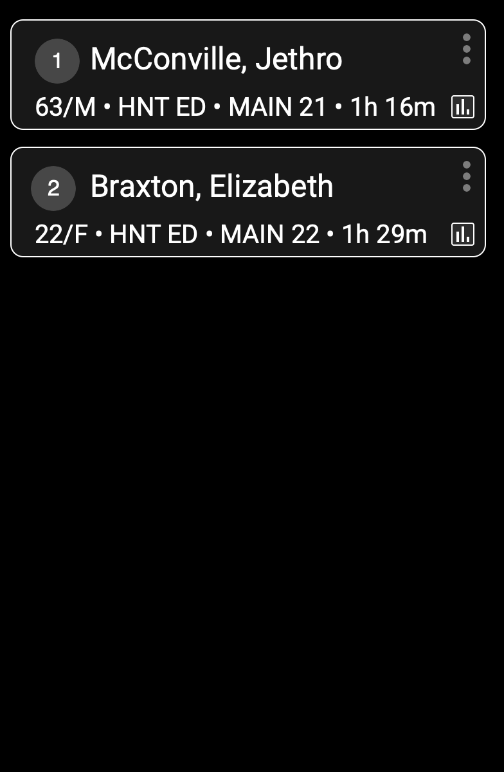
MOTION EXAMPLE

Slide 16
NEXT STEPS
Leverage concepts to inform product backlog and requirements activities (workshops) and include a lean UX design approach as part of agile product development. The concepts should also serve as a foundation for continuous and rapid planning, design, testing, validation and iteration of the user experience.
Position end-users (administrators and front-line workers) as stakeholders in the development process and engage them throughout the entire product lifecycle to validate solutions.
Establish a Center of Practice beginning with the creation and development of design system to standardize the design principles, UX guidelines, governance, and usage for product teams bring RAD to market.

Slide 17
Thank You

